Slide 1
Introduction to Data Science Final Project
Topic :
RCNN-Family
111550038 陳易
111550151 徐嘉亨
111550177 吳定霖

Slide 2
R-CNN

Slide 3
Region Proposals (selective search)
Feature Extractor (AlexNet)
Detector (SVM classifier, bbox regressor)

Slide 4
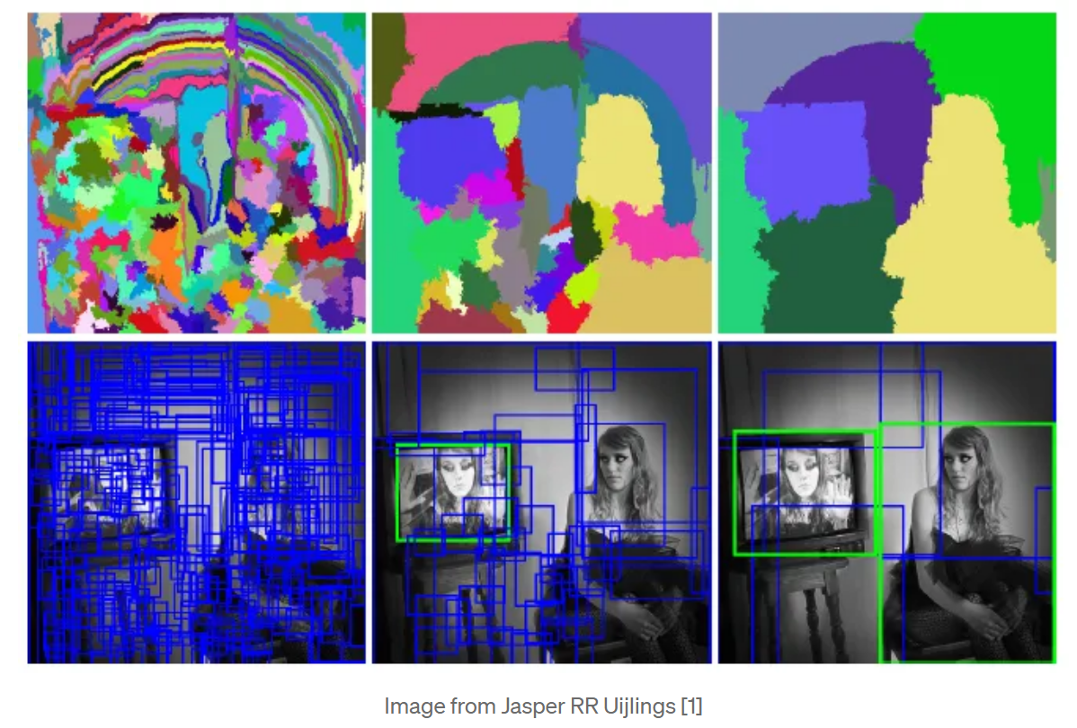
Region Proposals (selective search)

Slide 5
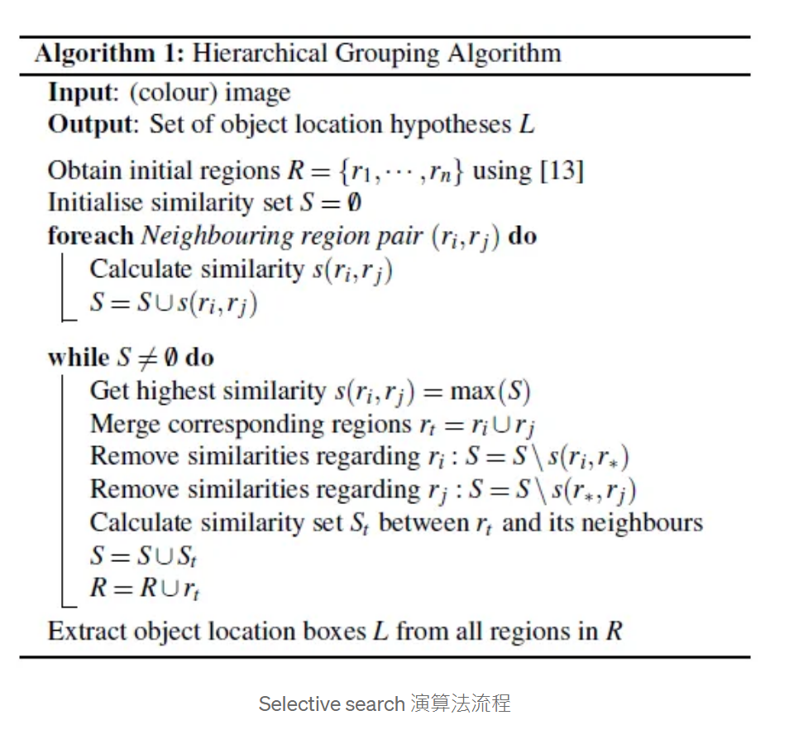
Region Proposals (selective search)

Slide 6
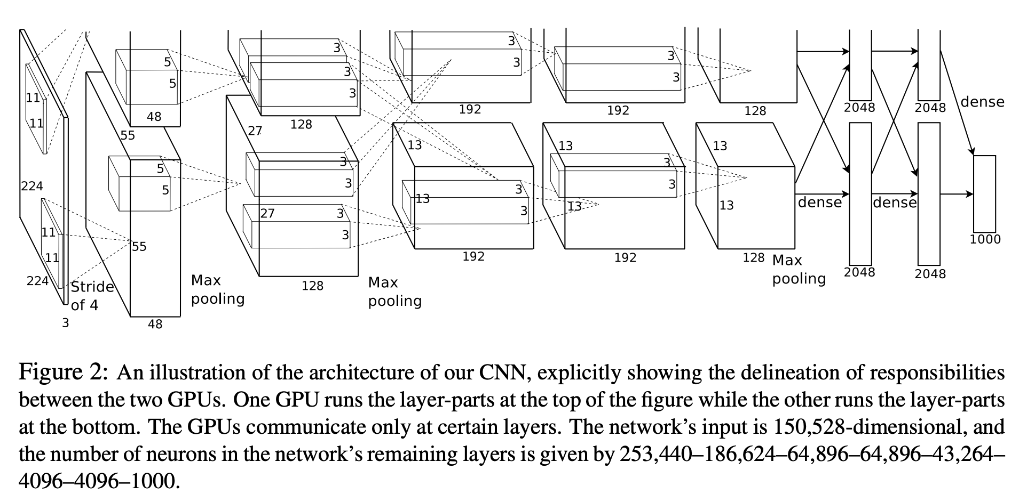
Feature Extractor (AlexNet)

Slide 7
Feature Extractor (AlexNet)
Replacing Sigmoid with ReLU in LeNet
Replacing Avg Pooling with Max Pooling
Use Dropout in sixth and seventh to replace Fully Connected NN

Slide 8
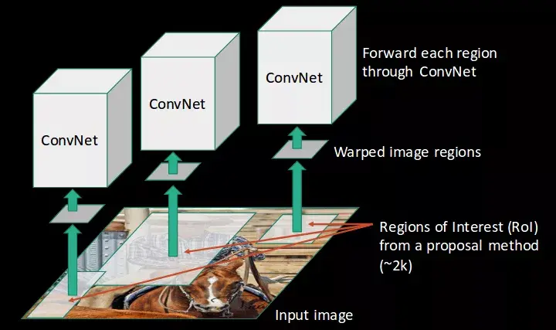
Feature Extractor (AlexNet)

Slide 9
Detector (SVM classifier, Bbox regressor)
SVM classifier -> classification
Bbox regressor -> regression

Slide 10
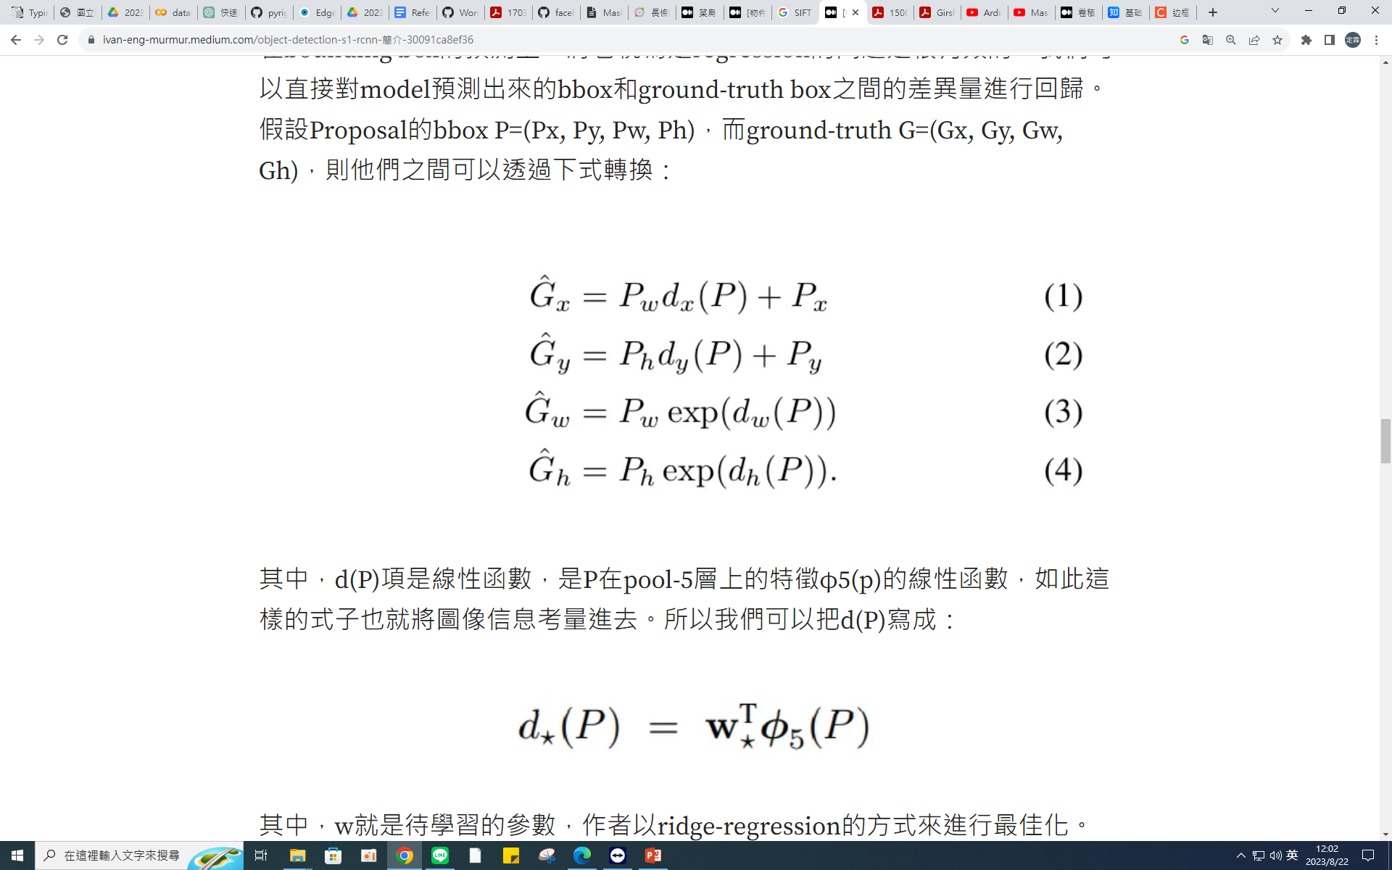
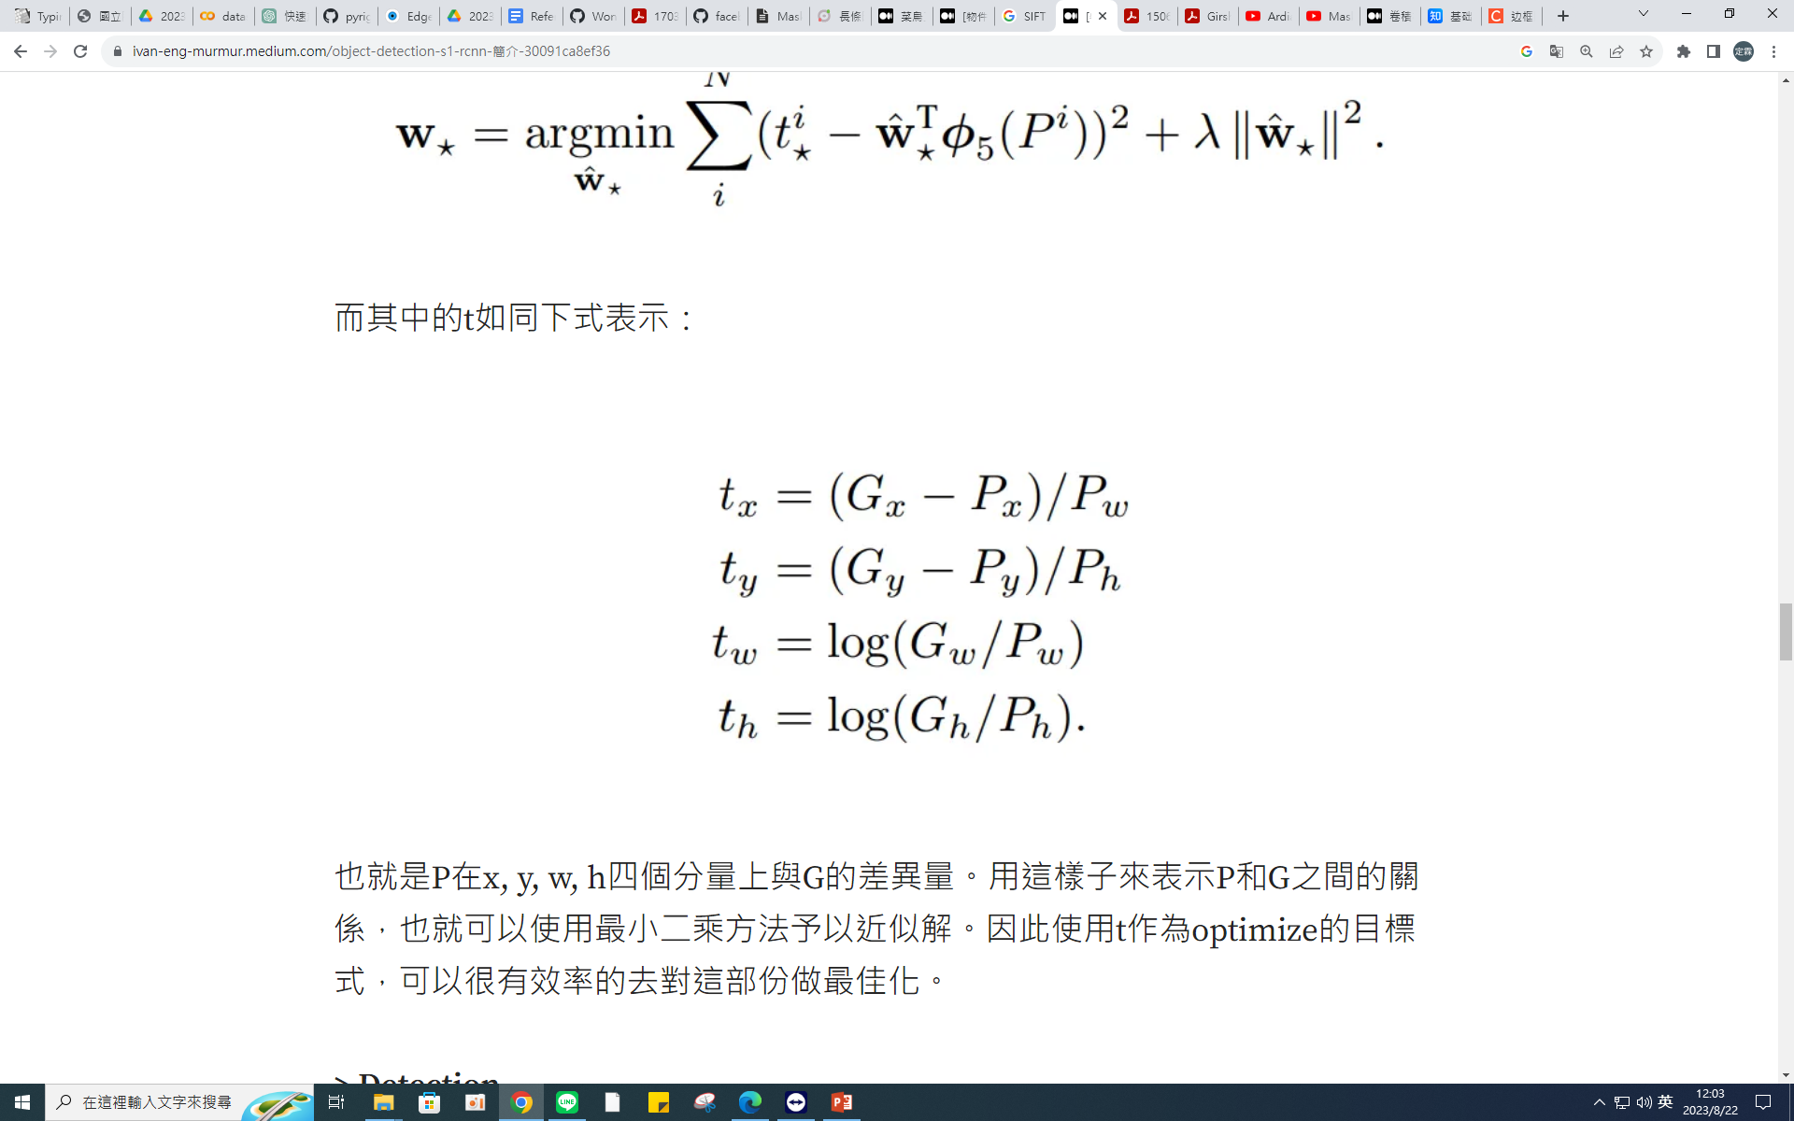
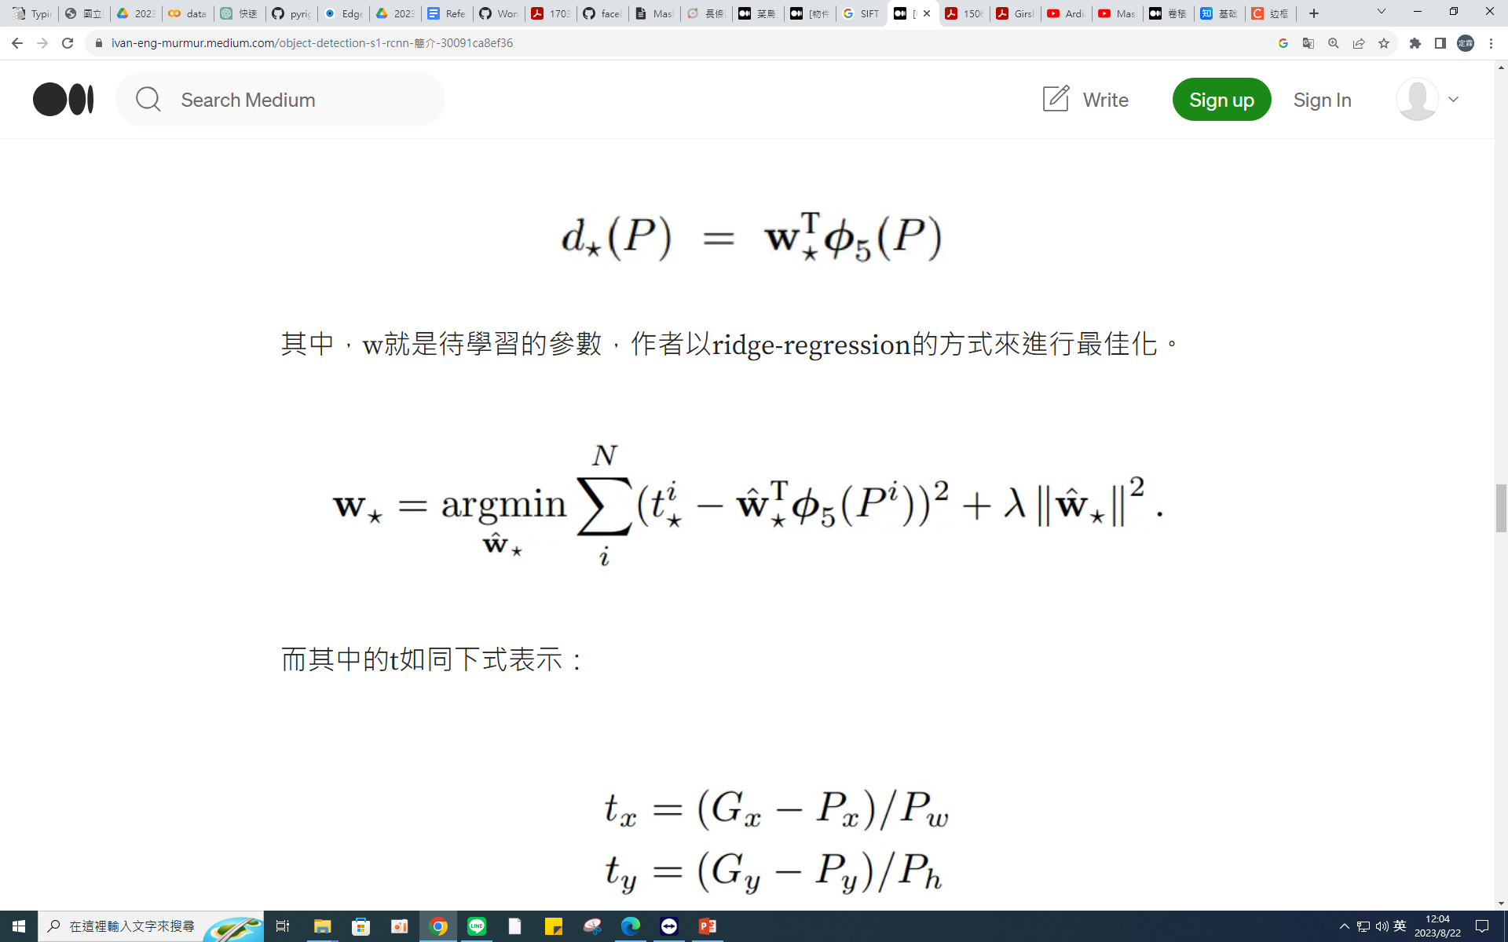
Detector (SVM classifier, Bbox regressor)

Slide 11
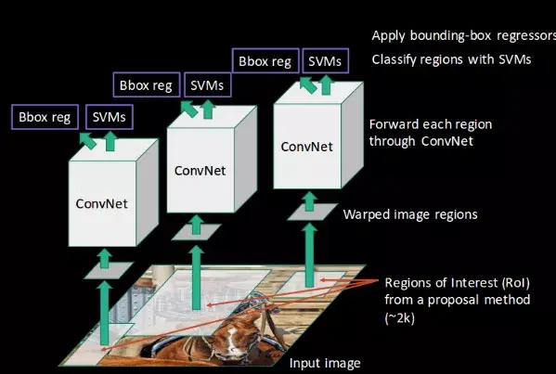
Detector (SVM classifier, Bbox regressor)

Slide 12
Shortcoming
Need large memory to store feature vector of proposal
Many times convolution training
47 seconds per detection

Slide 13
Fast R-CNN

Slide 14
Pass the entire image through convolution to generate a feature map.
Utilize ROI pooling layer to standardize dimensions.
Replace SVM with softmax for classification in the neural network.

Slide 15
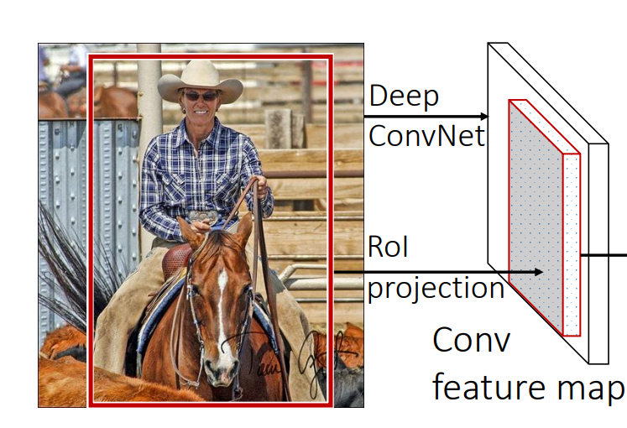
Region of Interest (selective search)

Slide 16
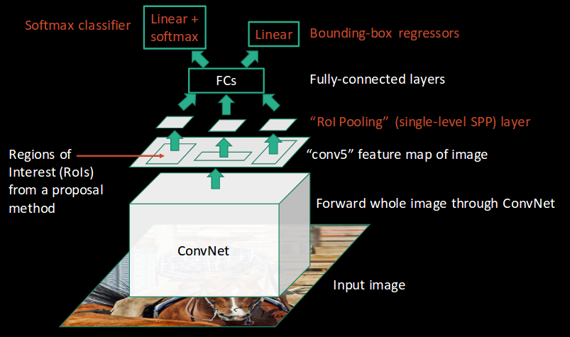
Region Proposals (selective search)

Slide 17
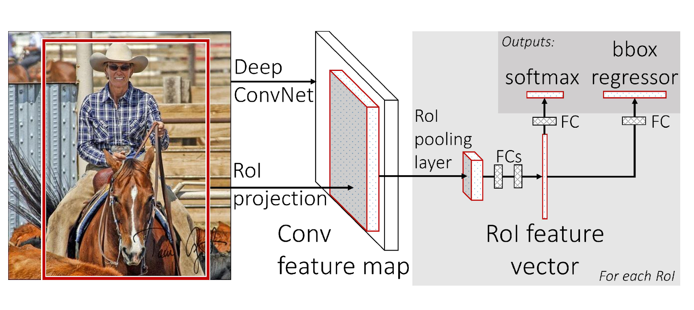
Feature Extractor (VGG net)

Slide 18
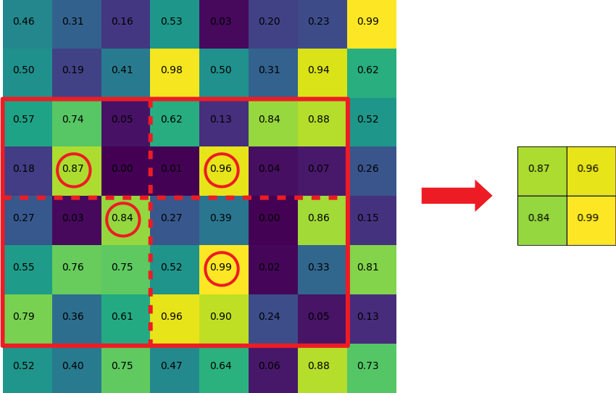
ROI Pooling Layer

Slide 19
Detector

Slide 20
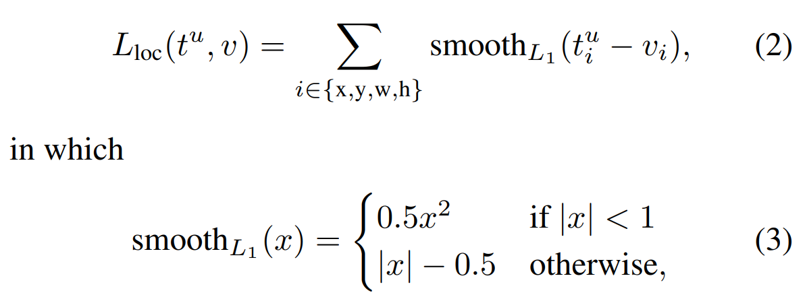
Loss Function

Slide 21
Shortcoming
25 times faster, but still too slow
Region Proposal bottle neck

Slide 22
Faster R-CNN
Notes:
“fast” is not enough, we need “faster”

Slide 23
Use Anchor
Replace Selective Search with Region Proposal Network
Notes:
There are two parts: one is a technique call Anchor, and the other is RPN

Slide 24
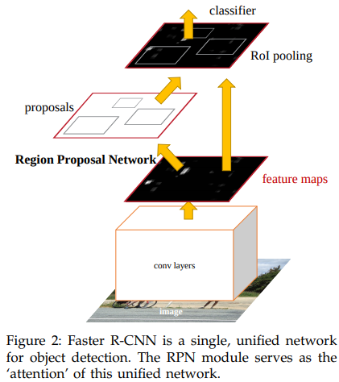
Notes:
Here’s the figure for workflow of Faster R-CNN. The difference from Fast R-CNN is it use RPN instead of selective search to do the proposal, which can be calculated by GPU that much faster than CPU.

Slide 25
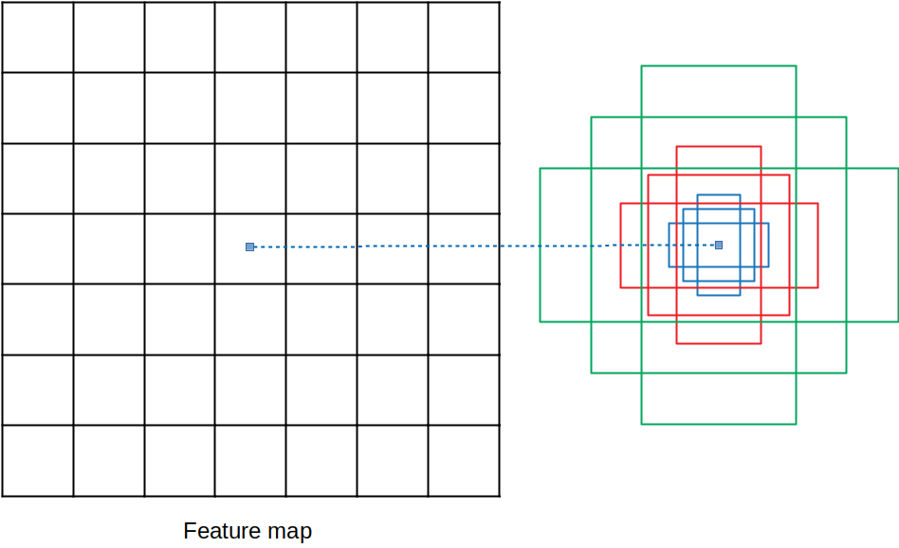
Anchor
K = 3 x 3 = 9
Notes:
As we can see, in this case, we have 3 scales and 3 aspect ratios, that k equals to 9.

Slide 26
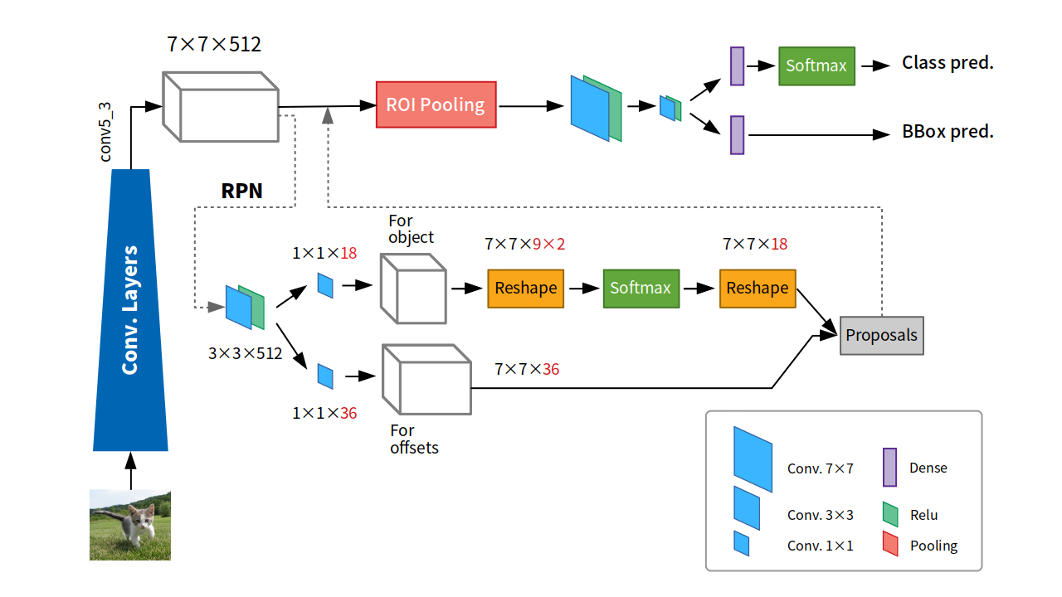
Region Proposal Network (RPN)
Notes:
Let’s take a look inside RPN. It do “anchor” for each block in 7 by 7 feature map, then get two parts, 18 for classification, 36 for regression.

Slide 27
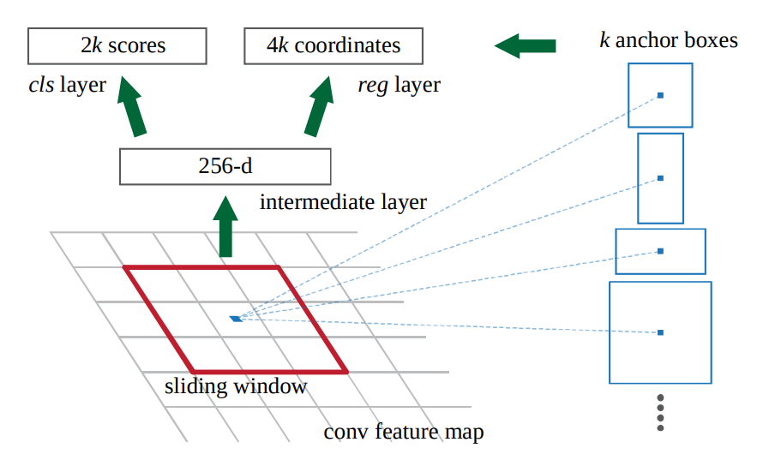
Region Proposal Network (RPN)
Notes:
Why it’s 18 and 36? It’s because we have k equals to 9. 2k means there “is” or "not" an object, 4k means x, y, width and height.

Slide 28
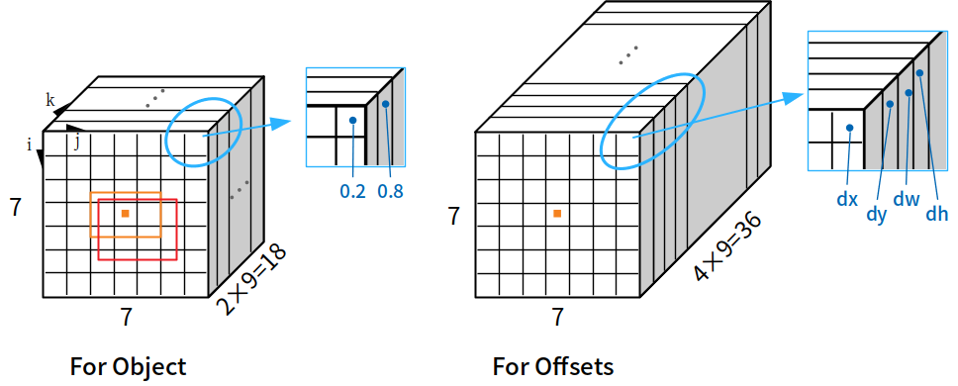
Region Proposal Network (RPN)
Notes:
And it looks like this.

Slide 29
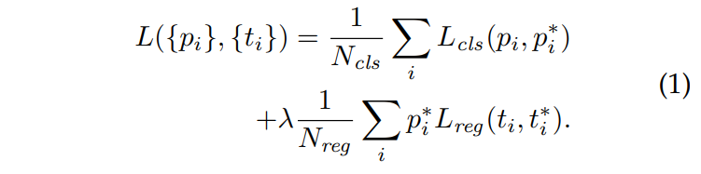
RPN Loss Function
Notes:
In the end, we take a look at the loss function. Due to the time, we only talk about one place. pi* is 1 if there’s an object, 0 otherwise. In other words, if there’s no object, the loss of regression is not important.

Slide 30
Mask R-CNN

Slide 31
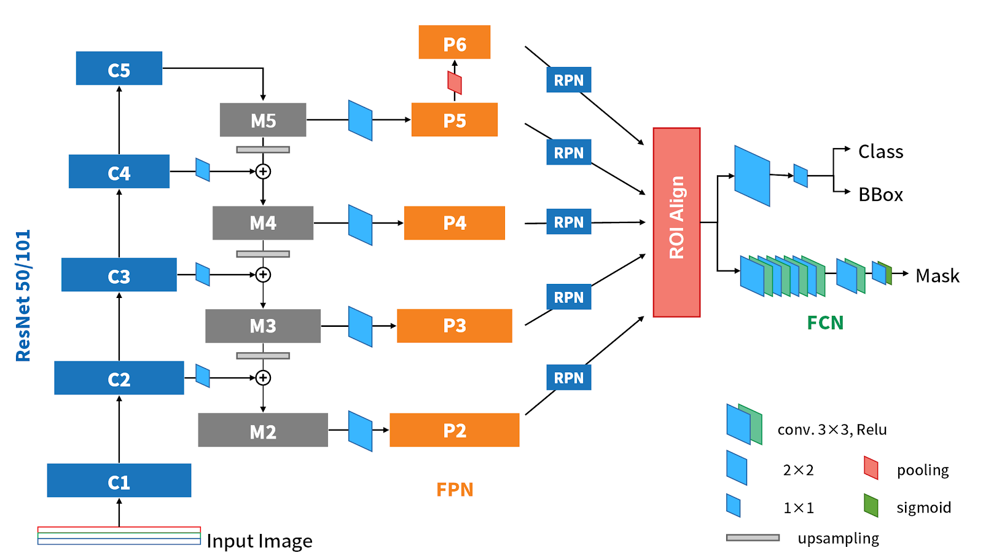
Region Proposal Network (RPN)

Slide 32
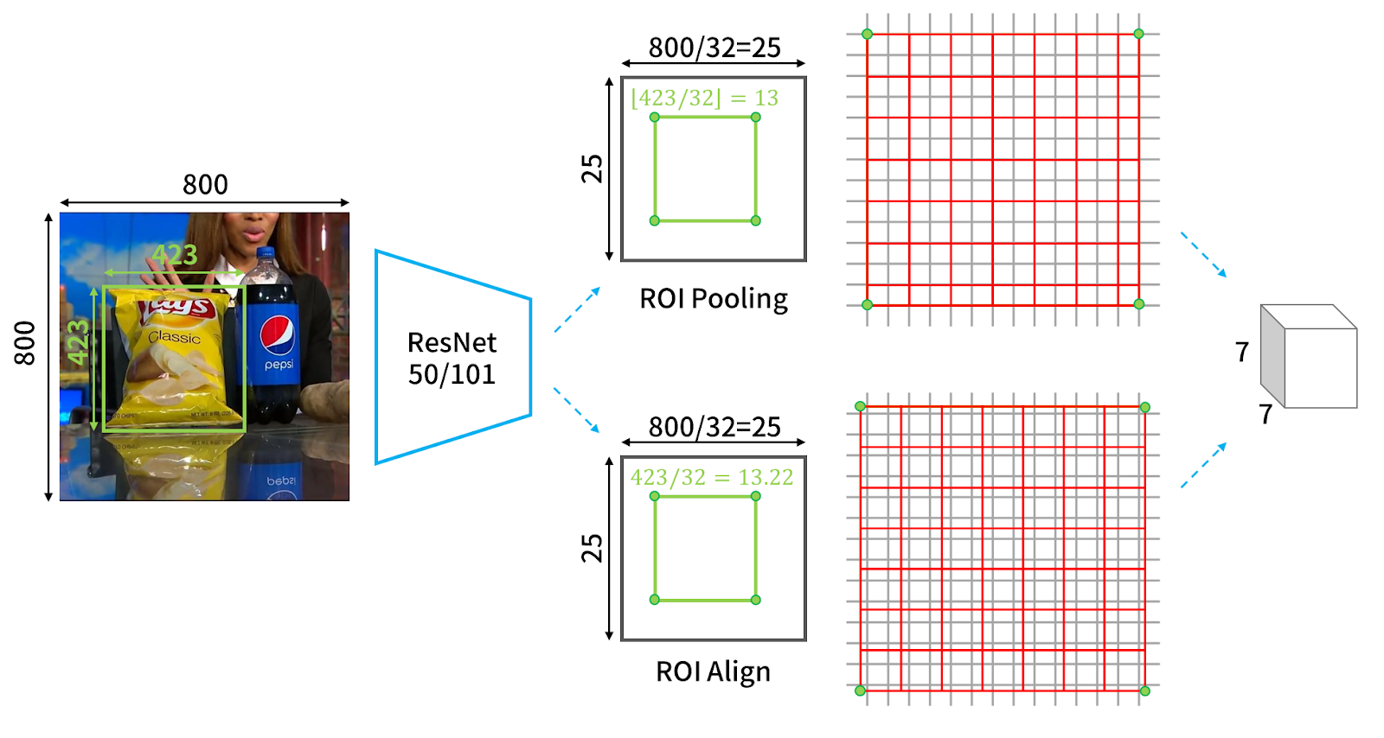
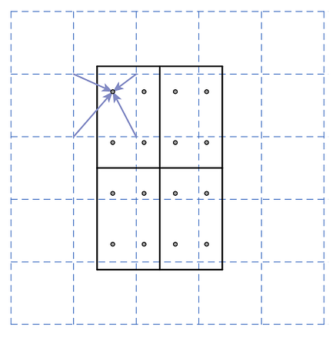
ROI Align

Slide 33
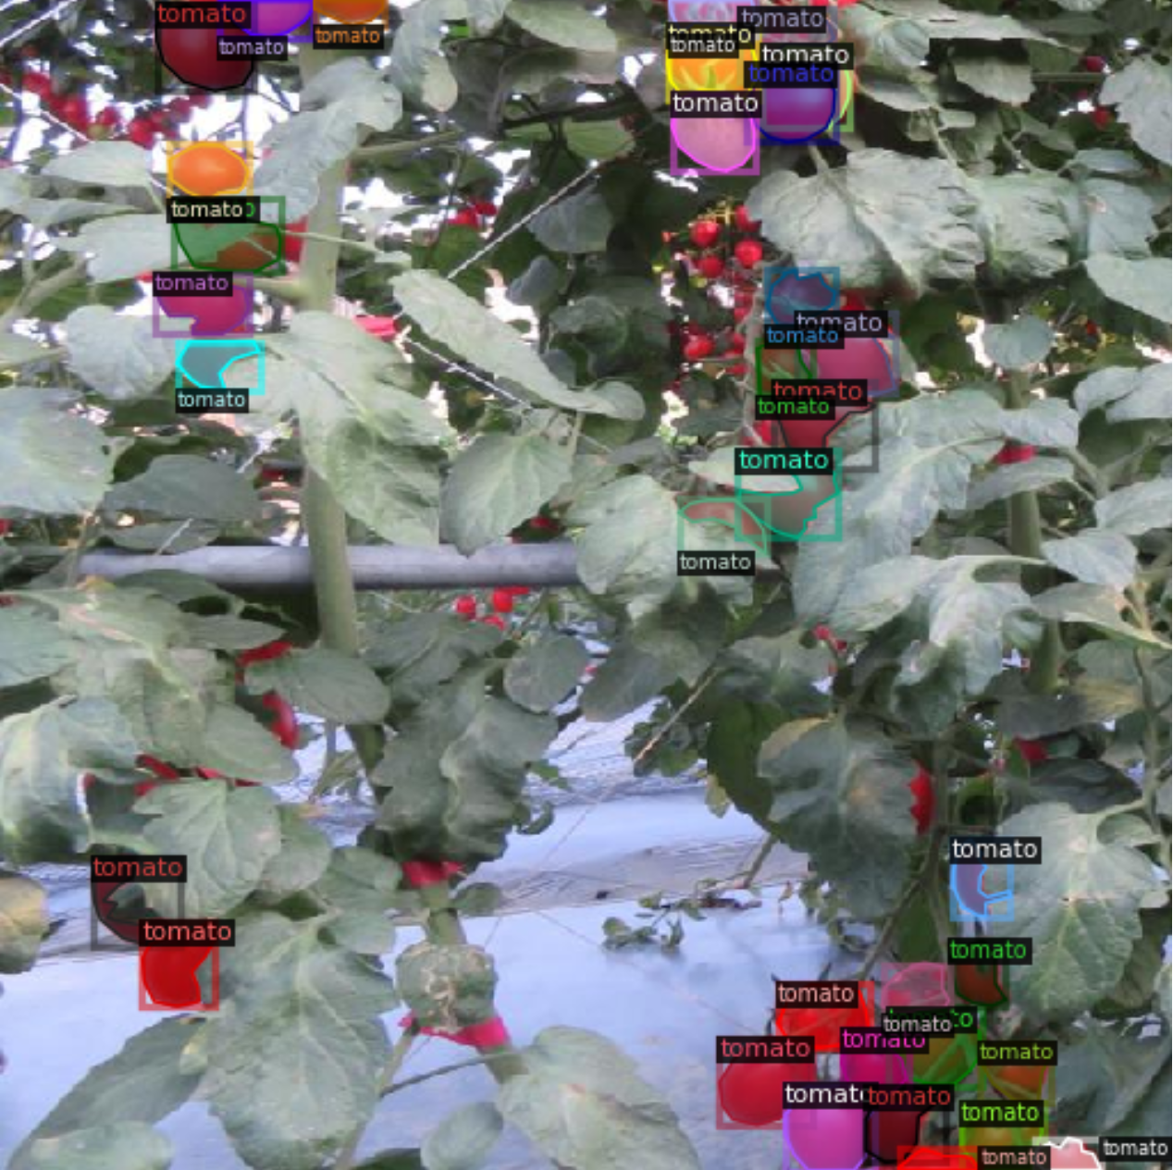
Detection Tomato
Label

Slide 34
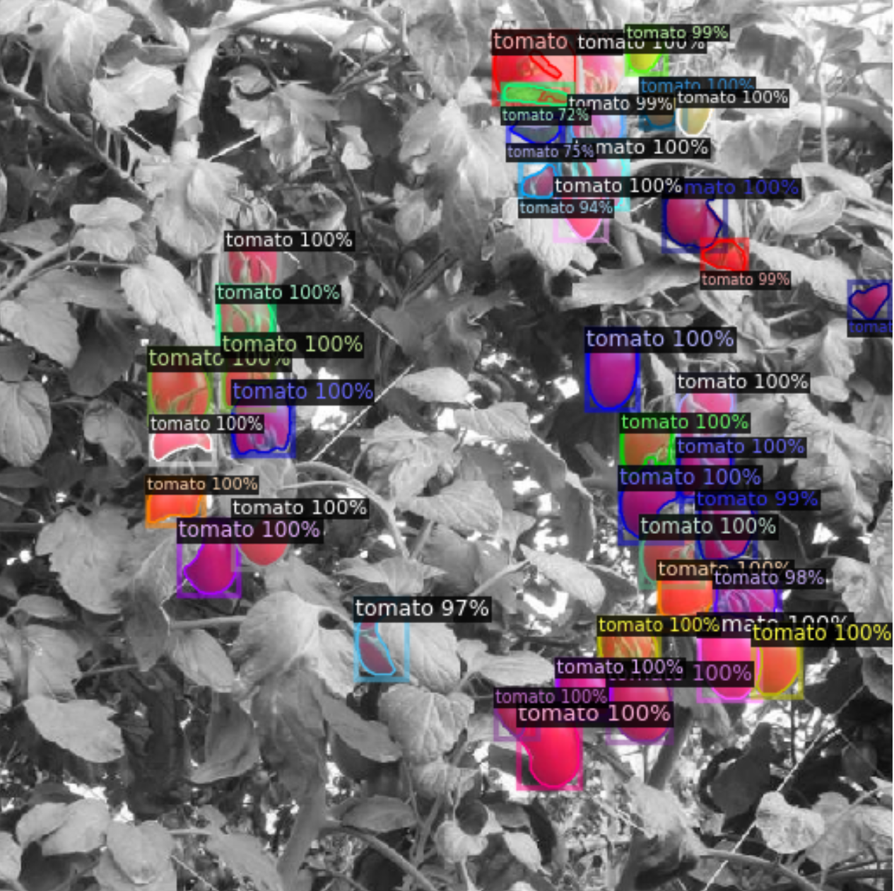
Detection Tomato
Predict

Slide 35
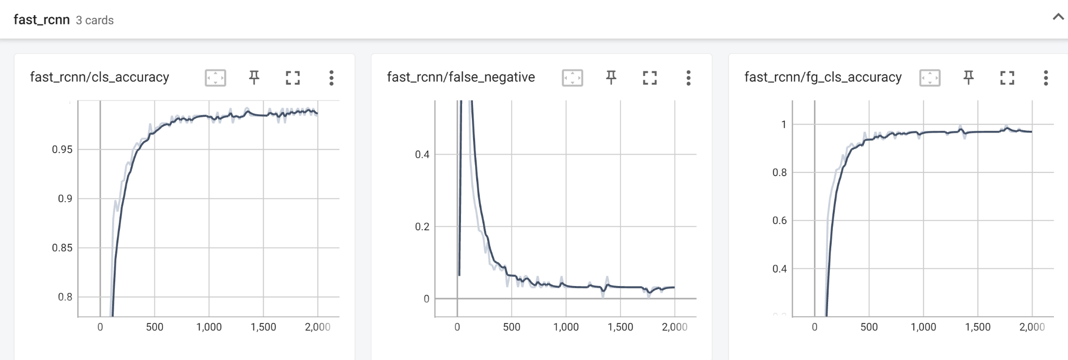
Detection Tomato

Slide 36
Code : https://colab.research.google.com/drive/1uy_55Ziq3U-FBIOlv-v8A2Hy3od4rWyr?usp=sharing
Reference :
https://github.com/facebookresearch/detectron2
https://arxiv.org/abs/1703.06870
For more information about Tomato Detection Demo, ask us in QA time :
https://hackmd.io/@2peEy1j8QSygBgdKIEZpJQ/HkIsfQih2

